Slide 1
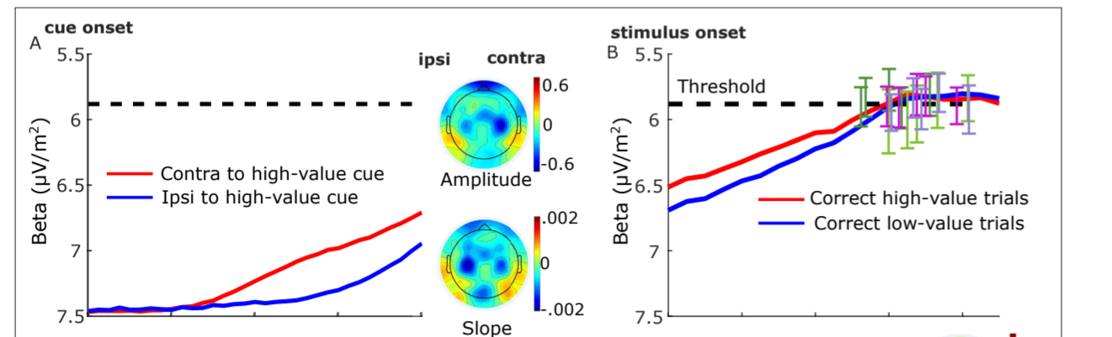
MB update 23/July/2024
Update MB baseline (f-domain)
Update Triger delay 60-70ms
Different baseline for diff condition????
SL- just before stimuli (-188)
RL-just before resp.

Slide 2
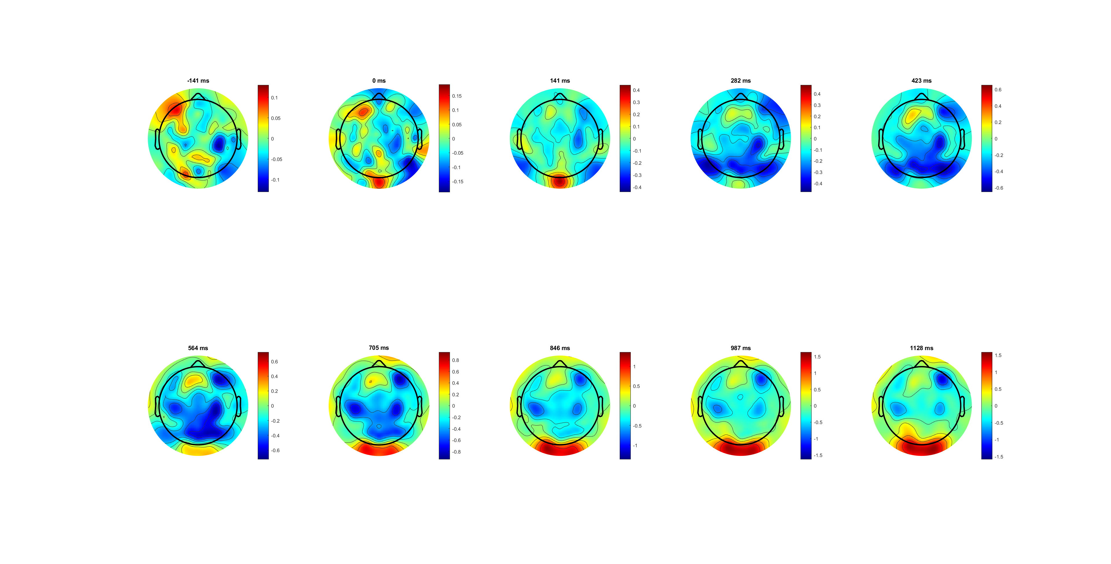
Left only Correct (dymic limit)

Slide 3
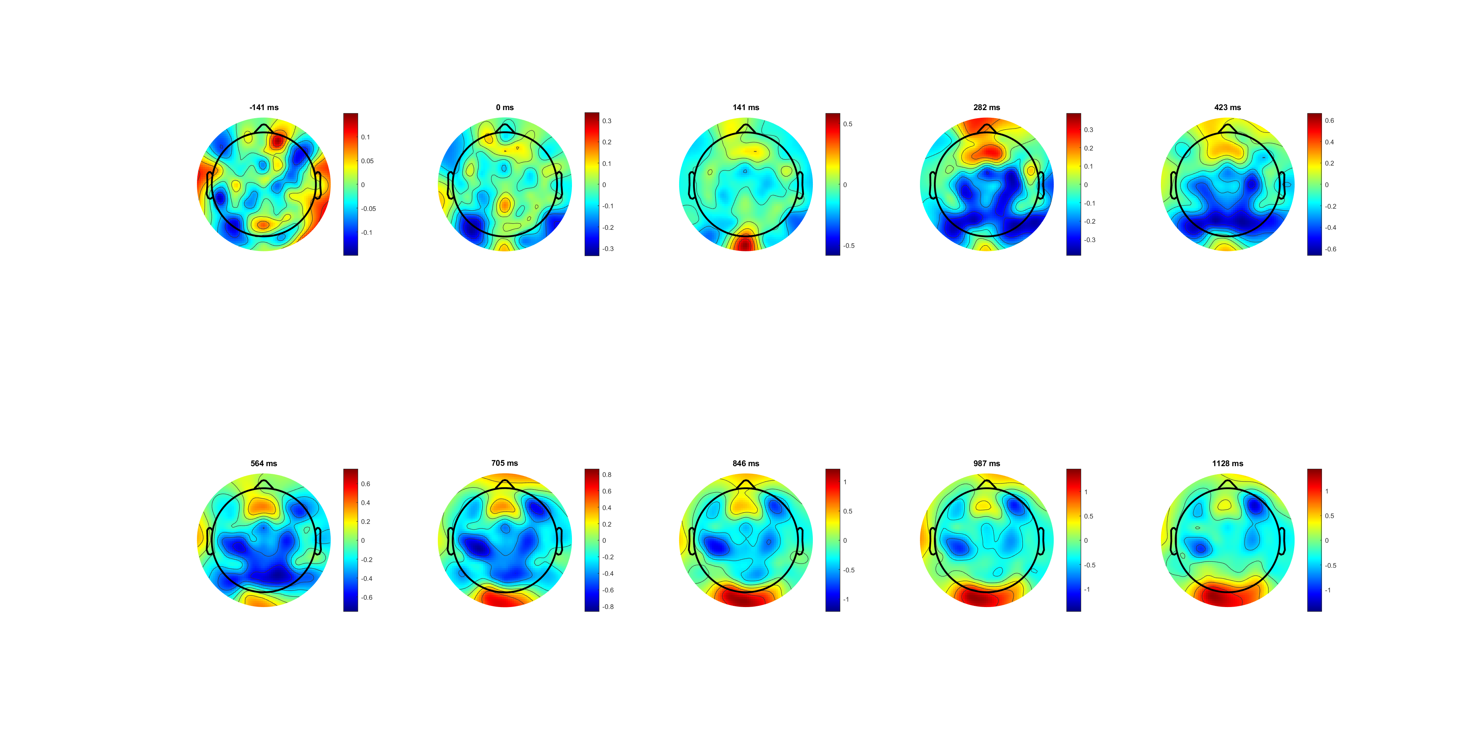
Right only correct

Slide 4
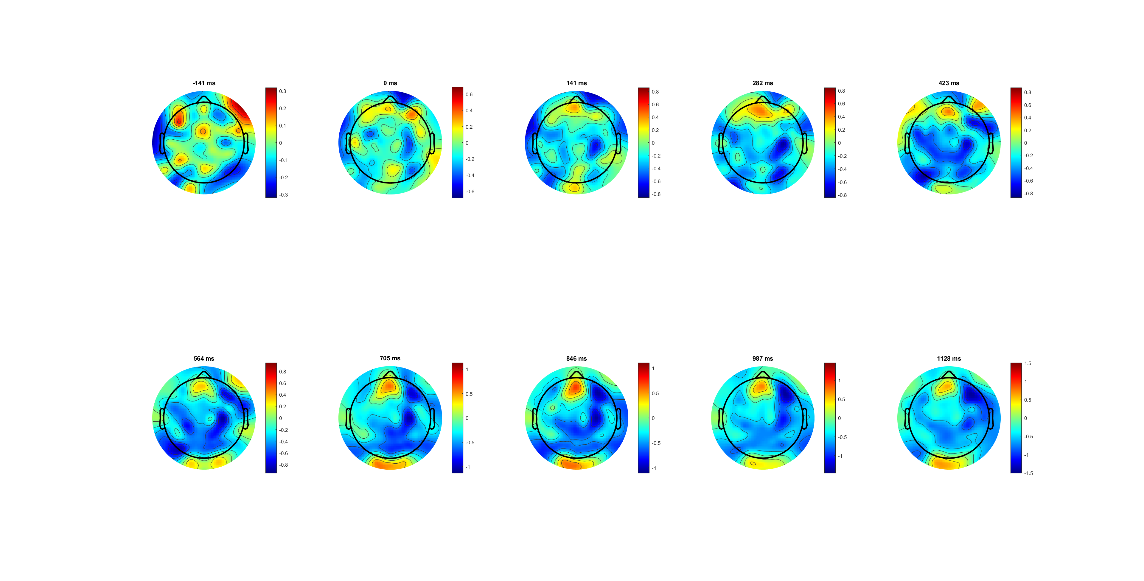
Left only wrong

Slide 5
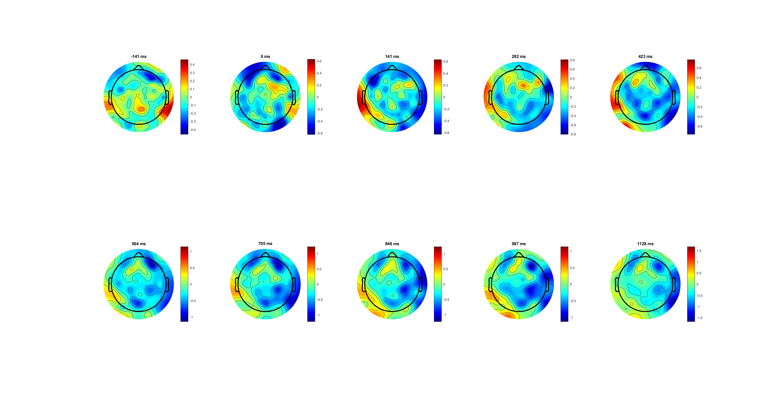
Right only wrong

Slide 6
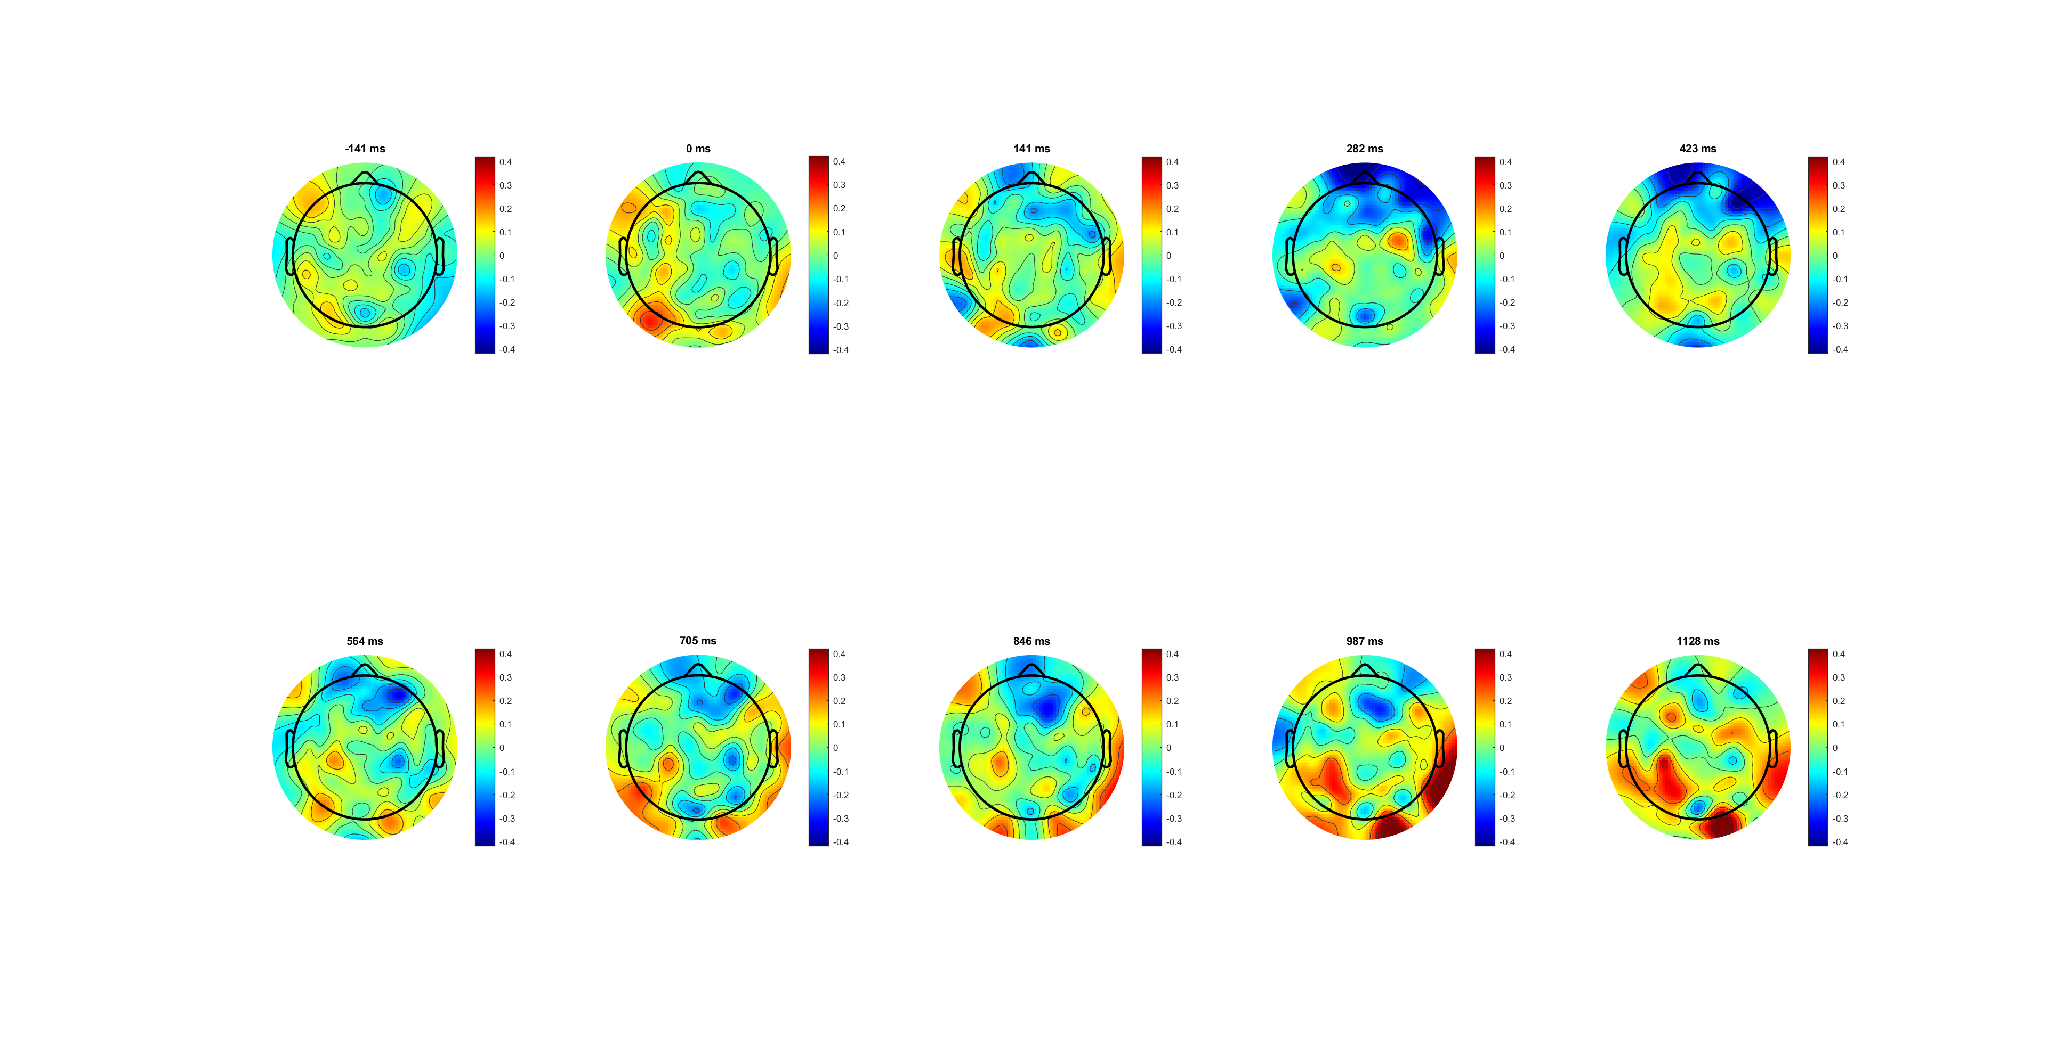
Correct lateralisation (L-R) 0.4limit
amplitude is lower contralateral to the button that was pressed

Slide 7
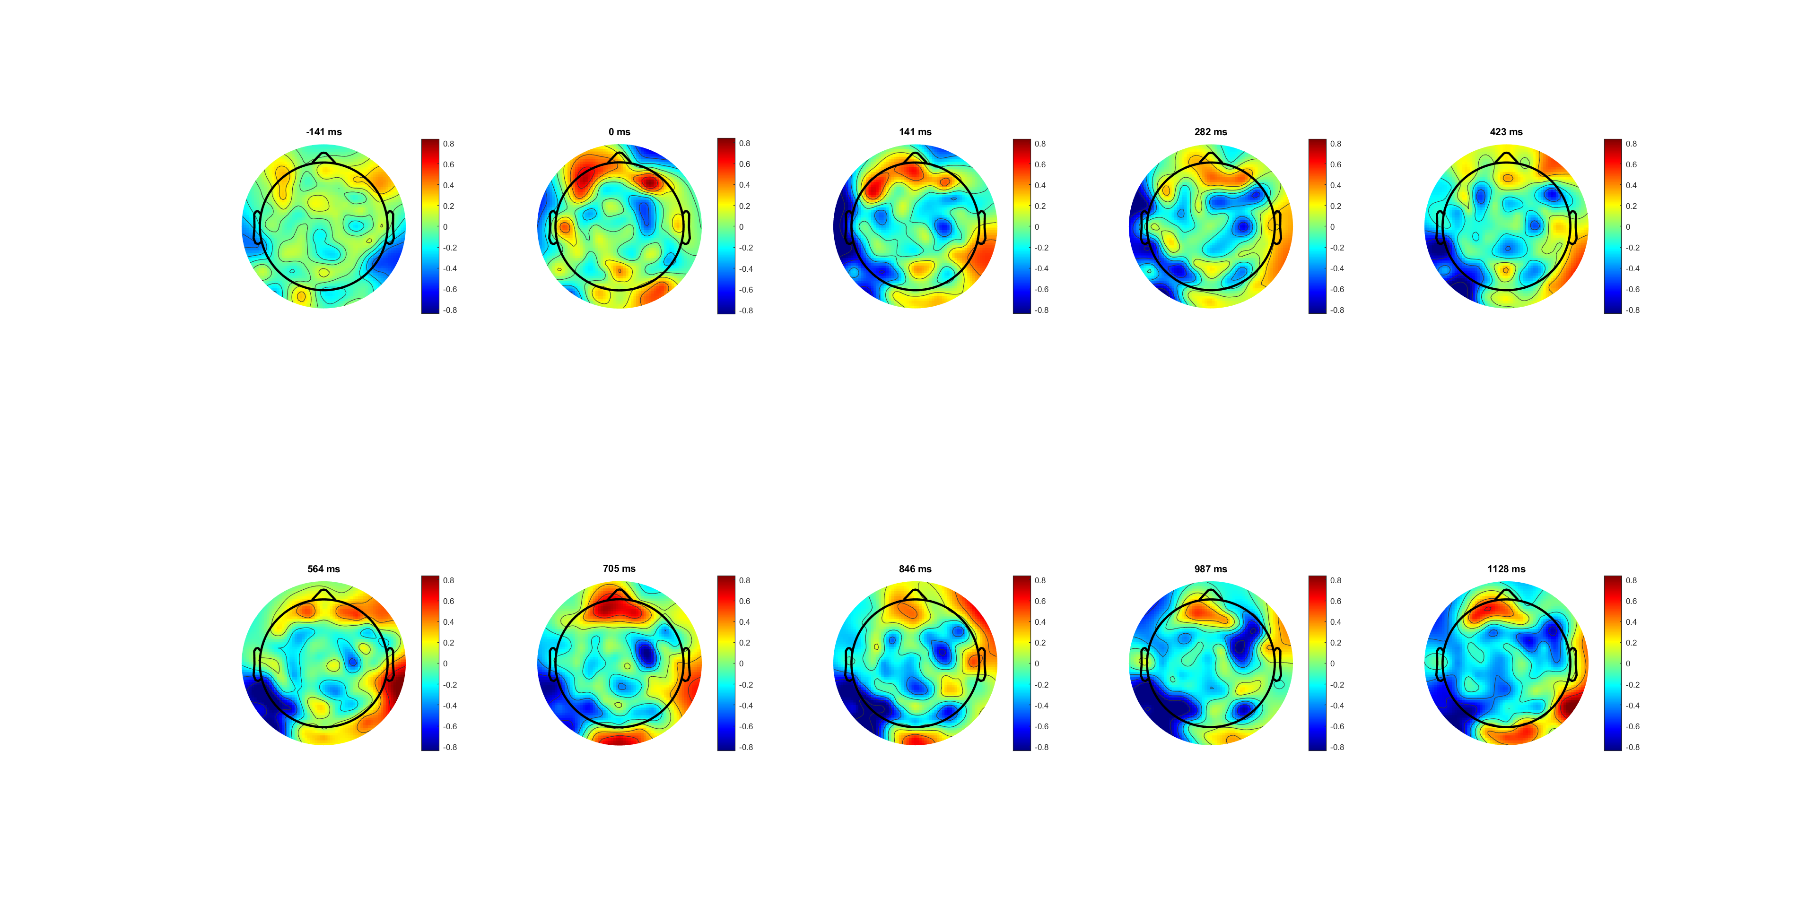
Wrong lateralisation (L-R) 0.8lim

Slide 8
Add average baseline?

Slide 9
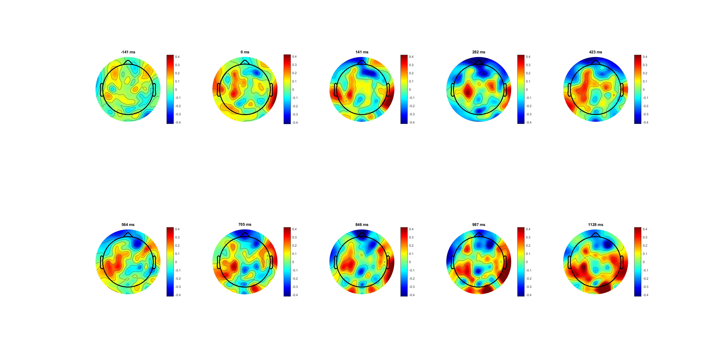
High 0.14 correct lateralisation (L-R) 0.4lim

Slide 10
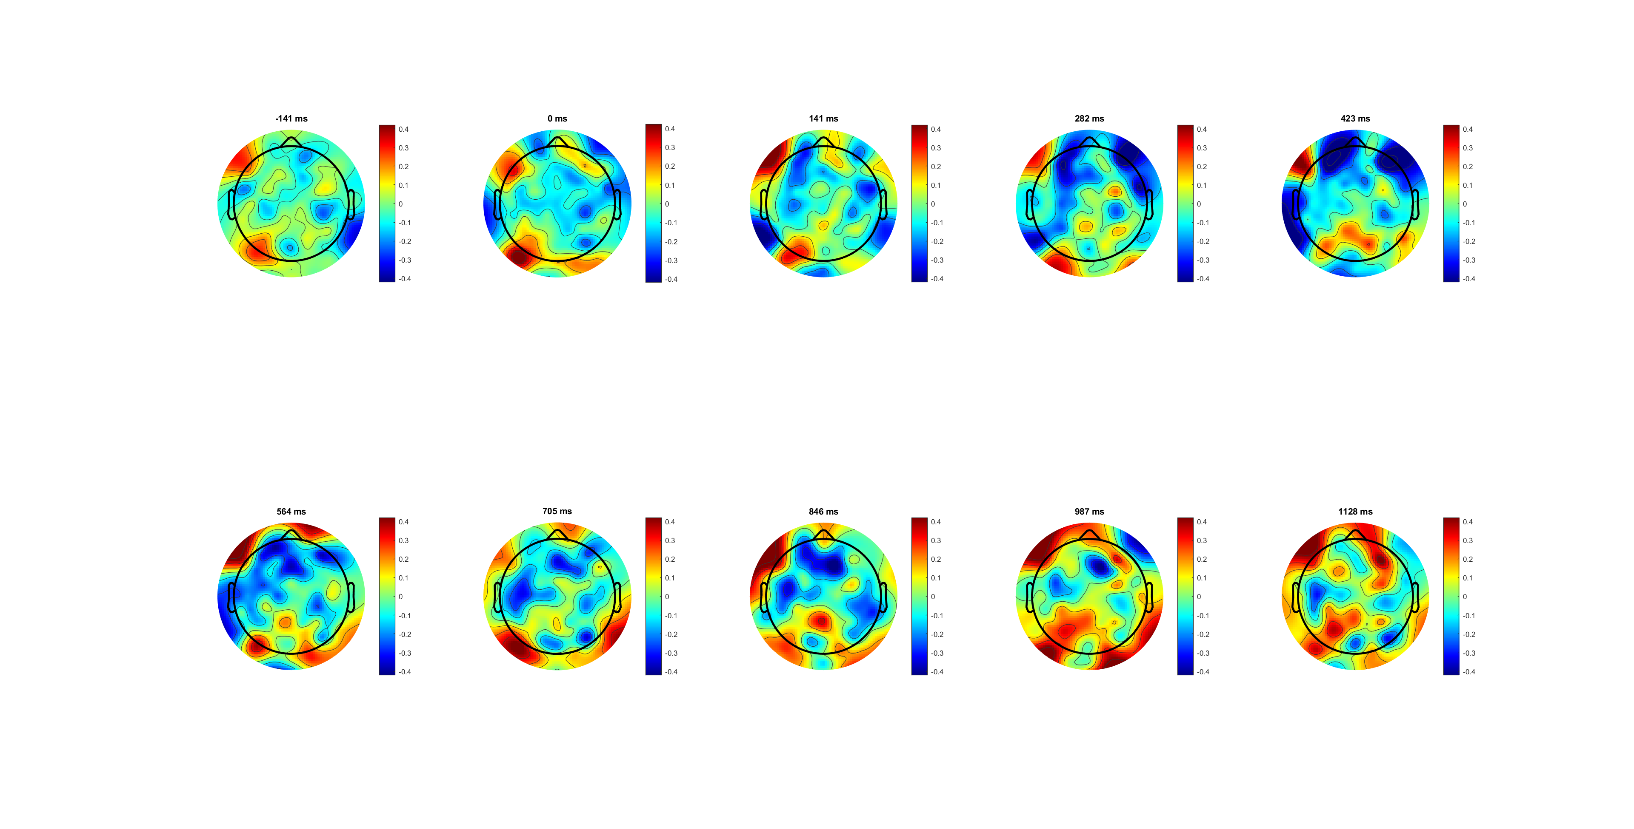
Low 0.07 correct lateralisation (L-R) 0.8lim

Slide 12
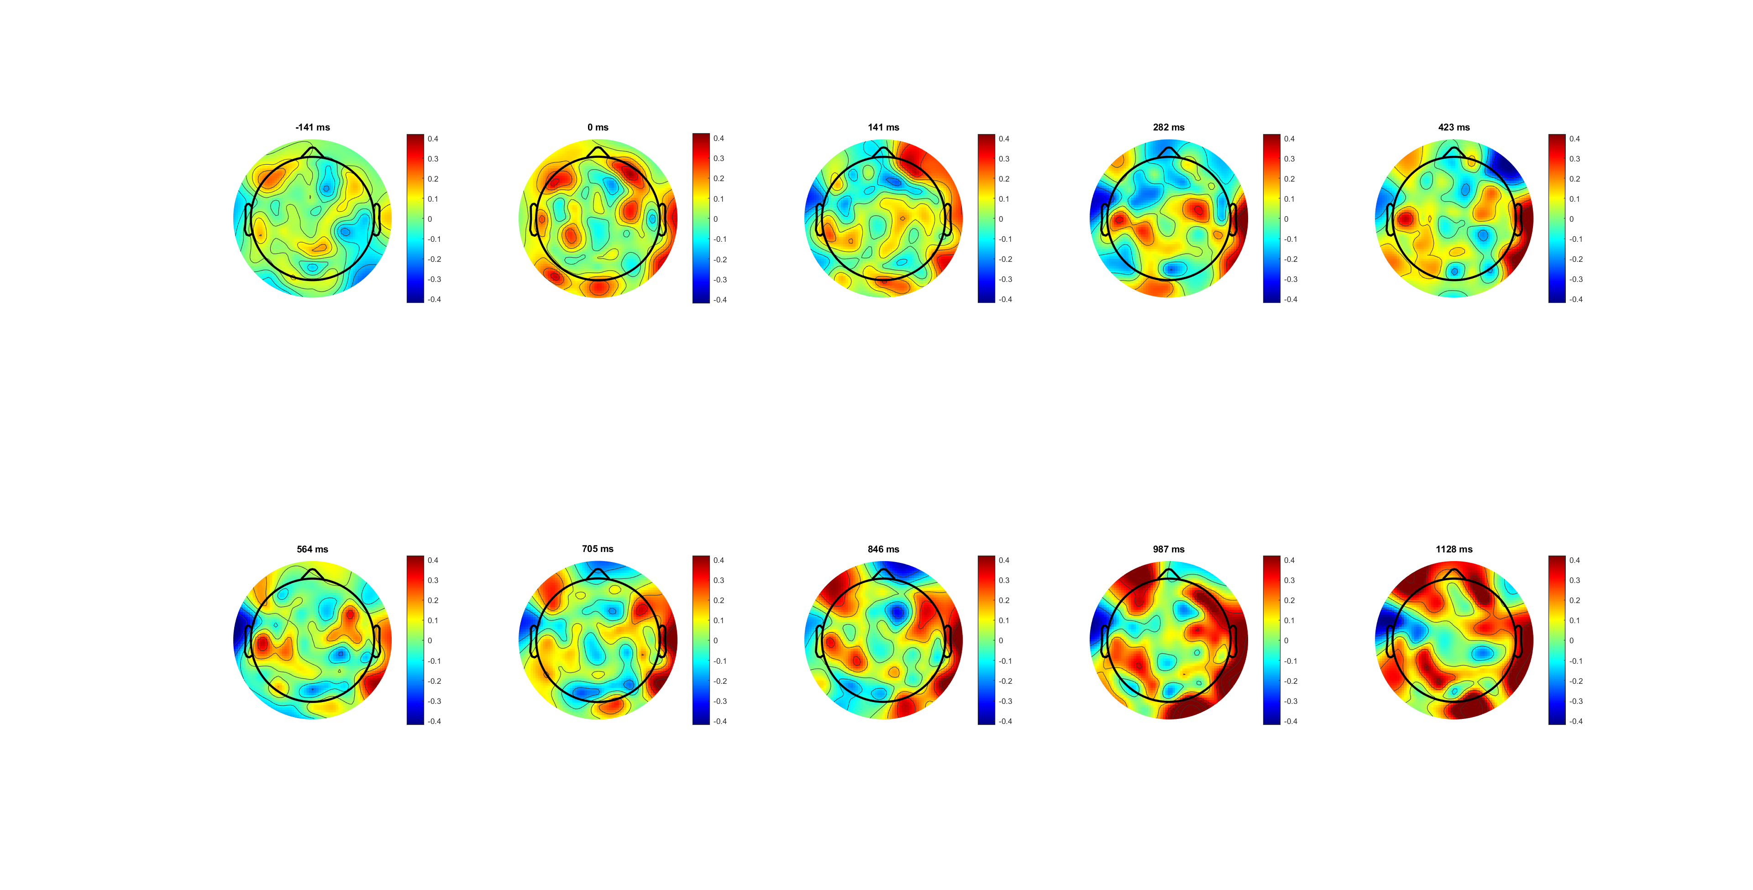
FDI

Slide 13
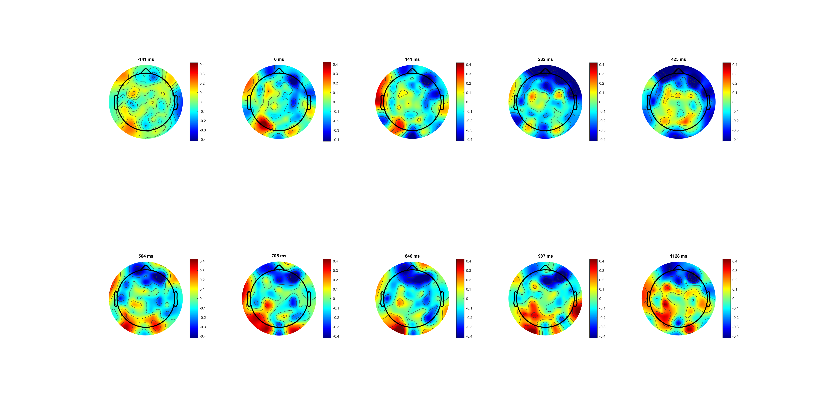
BCP

Slide 14
Different channels for FDI BCP?

Slide 15
find electrodes of interest； look at how the different frequency bands evolve over time for bicep and finger.

